Slide 1
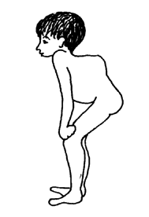
Pott disease
(tuberculous spondylitis)

Slide 2
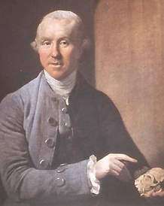
Introduction
Spinal tuberculosis
One of the oldest diseases known to mankind
Named for Percival Pott (1714 -1788) who presented the classic description of spinal TB

Slide 3
Epidemiology
Less common with the advent of
anti tuberculous drugs
improved public health measures
Serious morbidity
Permanent neurological deficits
Severe deformities

Slide 4
Demographics
The frequency of Pott Disease is related to socioeconomic factors and historical exposure to the infection.
The disease is more common in males (male-to-female ratio of 1.5-2:1).

Slide 5
Demographics
In the United States and other developed countries, Pott disease occurs primarily in adults.
In countries with higher rates of Pott disease, involvement in young adults and older children predominates.

Slide 6
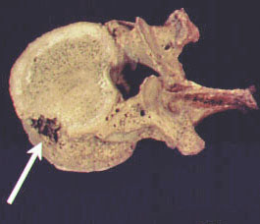
Pathophysiology
Pott disease is usually secondary to an extra spinal source of infection.
manifests as a combination of osteomyelitis and arthritis
The anterior aspect of the vertebral body adjacent to the subchondral plate is usually affected.

Slide 7
Pathophysiology
Tuberculosis may spread from that area to adjacent intervertebral discs.
In adults, disc disease is secondary to the spread of infection from the vertebral body.
In children, the disc, because it is vascularized, can be the primary site.

Slide 8
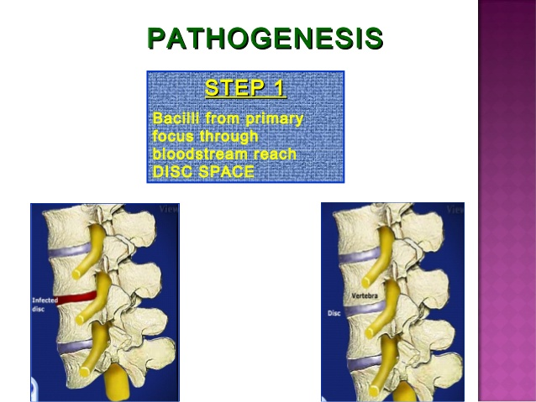

Slide 9
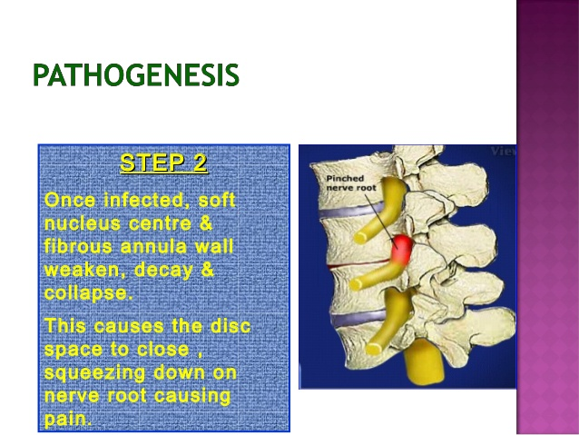

Slide 10
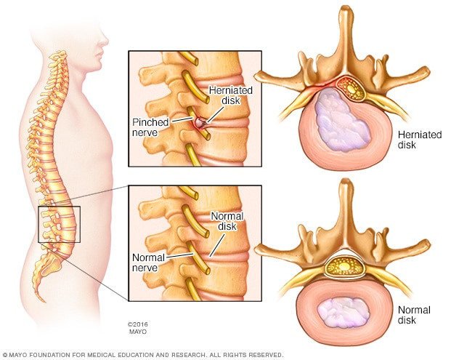

Slide 11
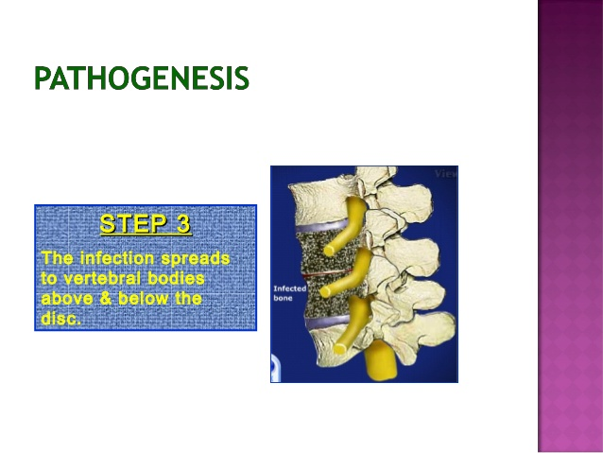

Slide 12
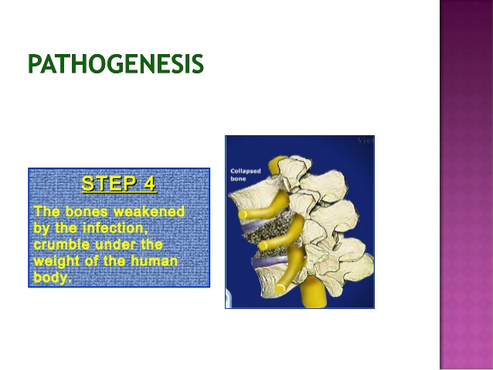

Slide 13
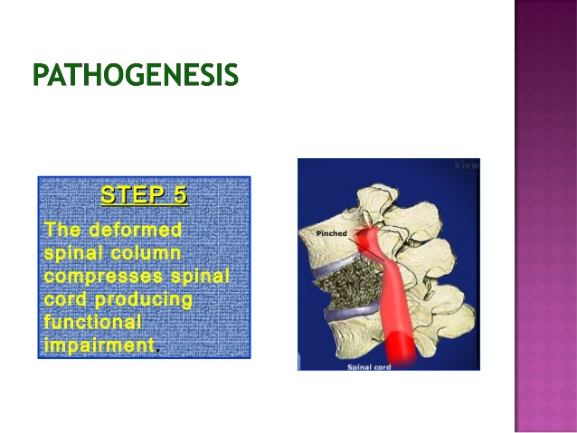

Slide 14
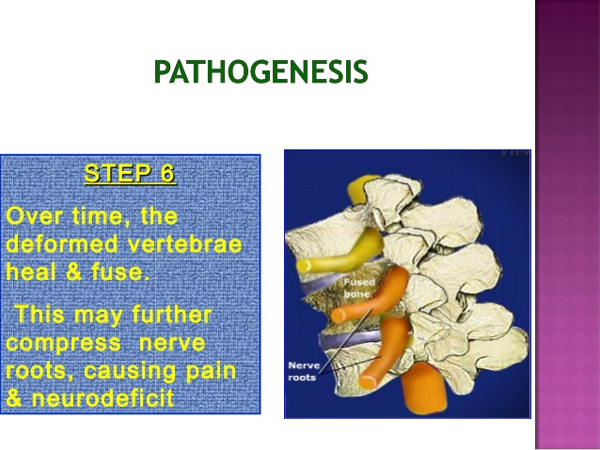

Slide 15
Pathophysiology
Progressive bone destruction leads to vertebral collapse and kyphosis.
The spinal canal can be narrowed by abscesses, granulation tissue, or direct dural invasion, leading to spinal cord compression and neurologic deficits.

Slide 16
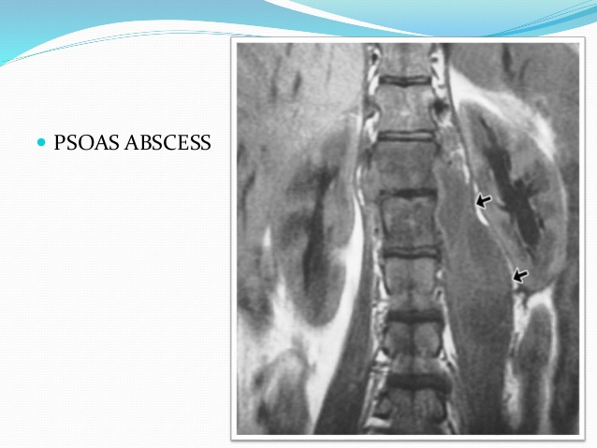
Pathophysiology
A cold abscess can occur if the infection extends to adjacent ligaments and soft tissues.
Abscesses in the lumbar region may descend down the sheath of the psoas to the femoral trigone region and eventually erode into the skin.

Slide 17
Clinical features
Back pain→ spinal or radicular
Constitutional features
Presentation depends on
Stage of disease
Affected site
Presence of complications such as neurologic deficits, abscesses, or sinus tracts

Slide 18
Clinical features
Neurologic abnormalities(50% of cases)
spinal cord compression with paraplegia
paresis
impaired sensation
nerve root pain
Cauda equina syndrome
Cervical spine tuberculosis -less common potentially more serious (severe neurologic complications)

Slide 19
Examination
Assessment of spinal alignment
Skin -sinuses
Abdomen- subcutaneous flank mass
Meticulous neurologic examination

Slide 20
Differential diagnoses
Metastatic cancer with unknown primary
Multiple myeloma
Actinomycosis
Blastomycosis
Cryptococcosis

Slide 21
Investigations
Tuberculin skin test (PPD) positive in 84-95% of patients with Pott disease
Erythrocyte sedimentation rate (ESR) - May be markedly elevated (>100 mm/h)
Microbiologic studies - Used to confirm the diagnosis
Percutaneous CT guided biopsy
Open drainage procedure

Slide 22
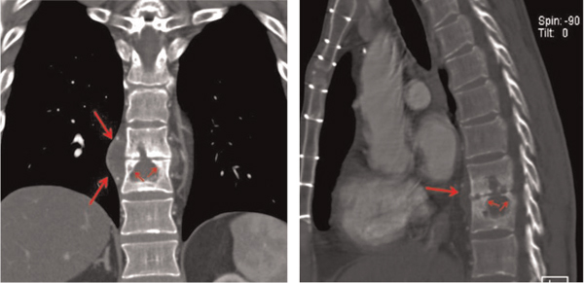

Slide 23
Treatment
Anti tuberculous chemotherapy
4HREZ/2HR
Surgical procedures
Abcess drainage
Obtain biopsy
Spinal stability/spinal cord threatened
Devices –external bracing
Multi disciplinary Care

Slide 24
Follow up
Assess
Response to therapy
Compliance with medication

Slide 25
Response
poor therapeutic response- progression of neurologic deficits, spinal deformity, or intractable pain
?antimicrobial drug resistance
Children with Pott disease should undergo long-term follow-up until their entire growth potential is completed

